Slide 1

Speak Fluently & Confidently B1- Course 1

Slide 2
Session 3- Talking about Driving
Part 1-: Driving and Directions (Listening)
Part 2: What would you say in the following
situations? ( Idioms & collocations)
Part 3: Speaking Practice
https://befluent.me/

Slide 3
Session 3-Talking about Driving
Part 1-: Driving and Directions
( Listening )
https://befluent.me/

Slide 4
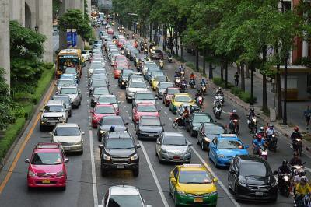
Lesson 7: Driving & Directions
Conversation #1 – Driving
Elizabeth: Hey Jonas! How was your road trip to Chicago?
(road trip = a long trip by car)
Jonas: It was a nightmare – one disaster after another.
Elizabeth: Huh? What on earth happened?
Jonas: Well, I offered to give my girlfriend’s brother a ride to Philadelphia. It was a bit out of our way – but that wasn’t the problem. The problem was that he’s a super- annoying backseat driver.
(out of our way = in a different direction from our planned destination / path)
Elizabeth: Really?
Jonas: Yeah, like – getting on my case for forgetting to use my turn signal before merging, or telling me that I should get out of the exit-only lane – on and on for about four hours.
(on and on = continuing)
Elizabeth: My mom is like that. I mean, it’s OK that she reminds me to buckle up, but I wish she wouldn’t scream “SLOW DOWN!” every time I go a tiny bit over the speed limit.
Jonas: Exactly. So after we dropped him off in Philly, we got stuck in a major traffic jam for over an hour before I finally managed to get off the highway and take a different road. But then there was a detour due to roadwork, and we got lost for another three hours.

Slide 5
Elizabeth: Wow, that’s nuts! Was it pretty smooth sailing after that?
Jonas: No, it gets worse. We made a pit stop outside of Cleveland, and I was in such a rush to use the bathroom that I locked my keys in the car.
(make a pit stop = stop driving to use the bathroom or to get food/drink)
Elizabeth: Oh no!
Jonas: After shelling out $50 for a locksmith, we were back on the road – but then the engine started overheating and I had to pull over.
(shelling out = paying money that you don’t want to pay)
Elizabeth: I think I would’ve given up if I were you!
Jonas: Yeah, but we were already over halfway there by that point, so I was determined to keep going. Just as we were getting to Chicago, another driver cut me off and I had to slam on the brakes to avoid crashing into him.
Elizabeth: Geez. I didn’t know Chicago drivers were so aggressive.
Jonas: Unfortunately, the woman behind me was talking on her cell phone and when I stopped suddenly, she rear-ended me.
Elizabeth: No way! Was your car badly damaged?
Jonas: Nah, it was just a fender-bender. My insurance will cover the repairs. But the whole trip was really stressful – next time, I’m just booking a flight!
(fender-bender = a very minor accident)
Conversation Vocabulary & Phrases
In the beginning of the conversation, Jonas offers to give his girlfriend's brother a ride - that means take him in the car. If you want to offer someone a ride, you can use these phrases:
"Do you need a ride / lift?"
"I'll pick you up at..."
(pick someone up = take the person in your car)

Slide 6
"I can drop you off at..."
(drop someone off = when the person leaves your car)
Unfortunately, the brother is a backseat driver – that’s a person in the car who is not driving, but who criticizes the driver’s abilities or who makes lots of suggestions and gives lots of tips for the driver to improve.
Some of the comments a backseat driver might make:
"You don't want to be in this lane - it's exit-only."
(roads are divided into lanes. An exit-only lane is one where the only option is to leave the highway)
"You forgot to use your turn signal / blinker before merging."
(turn signal / blinker = the yellow or orange light on the sides of a car, used to indicate the direction you plan to go. Merge = move from one lane into another)
"Slow down - the speed limit is 55."
(speed limit = the maximum velocity.
Slow down = drive slower. Speed up = drive faster)
"You missed your turn."
(you accidentally went past the place where you were supposed to turn right/left)
"Stop tailgating - it's not safe."
(tailgating = follow the car in front of you very closely)
"Everybody buckle up."
(buckle up = put on your seatbelt)
"It's getting dark - you should turn on your headlights."
(headlights = the lights on the front of the car)
During the conversation, a number of driving problems are mentioned:
"I got stuck in a traffic jam."
(traffic jam = when the traffic is stopped or slow)
"There was a detour due to roadwork."
(detour = an alternate route)
(roadwork = maintenance or repairs on the road)
"I got lost."

Slide 7
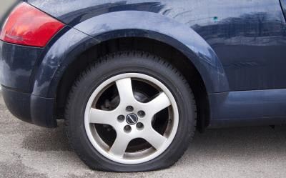
"I locked my keys in the car."
"The engine started overheating and I had to pull over."
(overheating = getting too hot)
(pull over = drive the car to the side of the road and stop)
"I got a flat tire."
(flat tire = when the tire loses its air)
"The car broke down."
(broke down = had a mechanical problem and stopped functioning)
"Another car cut me off."
(cut me off = another car drove in front of my car very suddenly)
"Another car rear-ended me."
(rear-ended = hit/crashed into the back of my car)
Conversation #2 – Asking for Directions
Tiffany is going to see a baseball game at Yankee Stadium – but she gets lost on the way, so she stops to ask for directions.
Tiffany: Excuse me. How can I get to Yankee Stadium from here?
Man: You have to get on the highway, but you already passed the onramp. So turn around and go back the way you came, and just follow the signs for I-95 South. Go about 5 miles on I-95 and get off at exit 2A.
(onramp = the access road where you can enter the highway)
Tiffany: Could you show me on the map?
Man: Sure. You’re here, and the highway is here. Exit 2A is here.

Slide 8
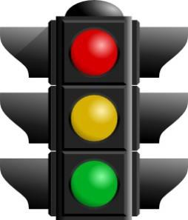
Tiffany: Thanks a lot.
(later, she gets off exit 2A, but doesn’t see any signs for the stadium)
Tiffany: Could you tell me how to get to Yankee Stadium?
Man: Yes, go past the gas station and turn left at the first light – that’s Walton Avenue. Go straight down Walton until you hit East 164th Street, and then…
Tiffany: Just a minute – let me write this down.
Man: OK. Take Walton to East 164th Street and turn right. If you see the mall, you’ve gone too far. After you’re on 164th then take your second left onto River Avenue – your best bet for parking is at the corner of River and 162nd Street.
Tiffany: Sorry, could you repeat the part about River Avenue?
Man: From 164th Street, you turn left onto River Avenue and just keep going until you see the parking lot. It’s about four blocks and it’ll be on your left, across from a hotel. Did you get all that?
Tiffany: I think so. Thanks.
Conversation Vocabulary & Phrases
To ask for directions, you can start with “Excuse me,” and then use these phrases:
“How can I get to… the Museum of Modern Art?”
“Could you tell me how to get to… Grand Street?”
“Where is… the nearest hospital?”

Slide 9
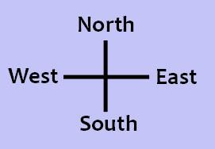
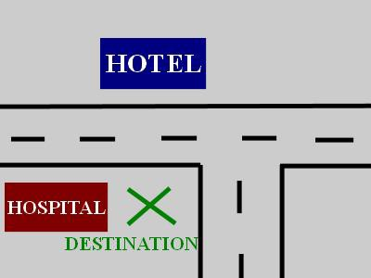
Directions are often given with these verbs:
go + direction
“Go right / left / straight / east / west / north / south.”
go + distance
“Go three blocks down this street, then turn left.” “Go five miles on Route 25W, then take exit 16.”
turn + right/left/around
take the second/third right/left
take + road name / public transportation
“Take Route 81.”
“Take Main Street north for about three miles.”
“Take the 3 train, then transfer to the F train at Fulton Street.” “Take the bus towards Chinatown.”
stay on + road (continue on the same street)
“Stay on this road for about five miles.”
“Stay on the highway for another ten minutes.”
When giving directions, it’s helpful to use landmarks – obvious reference points. For example:
“Go past the big white church.”
“When you get to the clock tower, turn left.”
“If you see a shopping mall, you’ve gone too far.”
“Turn right at the next light.”
(light = traffic light)
The destination will be…
on your left / on your right
across from… (a hotel)
next to… (the hospital)
on the corner
You’ve finished Lesson 7! Now take the quiz to test your memory of the phrases from this lesson.

Slide 10
If you’re ready for a speaking challenge, click here to leave me a message giving directions from your house to a destination you typically go (work, school, the supermarket, etc.)
Quiz – Lesson 7
After I'm on the highway, what do I take?
block B. onramp C. exit
Just a moment - let me write this .
off B. up C. down
Should I left or right at the light?
follow B. pass C. turn
How can I to the National Theater?
arrive B. travel C. get
Can you me on the map?
show B. find C. see
on the highway for another fifteen miles, then take exit 12.
keep B. stay C. take
If you see the university, then you've gone too and you'll need to turn around.
far B. long C. much
Thanks for offering me a ride. Can you me up in about twenty minutes?
get B. pick C. take
Driving fast when it's raining is dangerous - you should down.
buckle B. slow C. speed
Excuse me, where is the gas station?
longest B. farthest C. nearest

Slide 11
The first time I drove in Philadelphia, I got and had to stop and ask for directions.
lost B. missed C. jammed
Don't take the highway - they're doing some and two lanes are closed.
detour B. merging C. roadwork
Sorry I'm late - I got a tire and I had to call a friend to help me change it.
broken B. cut C. flat
I dropped my sister at school on my way to work.
off B. out C. up
She's so forgetful, she her keys in the car at least once a week.
locks B. misses C. shuts

Slide 12
Lesson 7 Quiz - Answers
1.C 2.C 3.C 4.C 5.A 6.B 7.A 8.B 9.B 10.C 11.A 12.C 13.C 14.A 15.A

Slide 13
Session 3- Talking about Driving
Part 2: What would you say in the following
situations? ( Idioms & collocations)
https://befluent.me/

Slide 14
Session 3- Talking about Driving
To Buckle Up
Meaning: to put on your seat belt
Example:
Okay, kids, buckle up, and we’ll be on our way.
The buckle is the part of the seat belt that clicks click into the little holder.
To Pull Up
Meaning: to stop
Example:
All vehicles must pull up at the traffic lights.
To Drop Off
Meaning: to take someone to a place in a car
Example:
Can you drop me off at the bus stop?
To Drive Off
Meaning: to leave in a car
Example:
He dropped us off at the airport and drove off without even saying goodbye.
https://befluent.me/

Slide 15
Session 3- Talking about Driving
To Cut In
Meaning: to make a sudden and quick movement to position your car in front of another car, often without indicating properly
Example:
The car that cut in front of me seemed to be out of control.
To Tick Over
Meaning: we use it to describe a car engine operating at an idle pace in neutral without your car moving
Example:
Letting your car to tick over for 10 minutes generates a lot of emissions.
So there are our phrasal verbs related to driving. Let me give them to you one more time:
to back up to buckle up to fill something up to load something up to slow down to block somebody in to pull out to pull in to pull over to pull up to drop someone off to drive off to cut in to tick over
A Back Seat Driver
Always try to avoid being one of these. When you are used to driving and you are getting a lift as a passenger with a friend or family member avoid the temptation to tell them what to do and what not to do.
Example:
David was getting a lift to the airport from his wife. She was dropping him off (taking him there) on her way to work.
– Mind that car, slow down here, watch that guy on your left
– Oh David stop I don’t need a back seat driver!
A Sunday Driver
You are driving with the family going to a picnic on a sunny Sunday afternoon. The traffic is quite light but there is someone driving in front of you who is driving very slowly and admiring the view. Your only wish is that he would pull over and let you go past him (overtake). These Sunday drivers would drive you mad!!
https://befluent.me/

Slide 16
Session 3- Talking about Driving
A Road Hog
This is even worse than a Sunday driver. The guy is driving reasonably fast but his car is not as powerful as your car but he does not want to let you go past. He drives in the middle of the lane or worse still between two lanes and you cannot get past him. Road hogs usually think they own the road.
Example:
Road Hog, why is he hogging all the road! (why does he want all the road!)
Honk The Horn
Nothing annoys me more than to be sitting in my car at the traffic lights waiting for the lights to turn green and the car immediately behind you honks on the horn (beeps on the horn) impatiently the split second (just before) the lights turn green.
To Be In The Driving Seat
Not necessarily connected with driving. This expression is used to describe someone who finds himself in control of a situation in business or in his/her private life.
Example:
Margaret couldn’t wait to get to work on Tuesday. The events of Monday meant that she was now in charge of the project and the team knew who was in control. She had got what she wanted. She was very firmly (definitely) in the driving seat and she loved it.
https://befluent.me/

Slide 17
Session 2- Talking about Driving
Part 3: Speaking Practice
https://befluent.me/

Slide 18
Session 2- Talking about Driving
Do you like driving / sitting in a car? (what other expressions can we use to say the same question?)
2) What does driving mean to you?
3) Do you think people change character when they are behind the wheel?
4) Have you ever been in / had / seen a driving accident?
5) Do you think driving is dangerous?
6) What’s the most dangerous piece of driving you’ve ever seen?
7) Do you (or someone you know well) always follow the rules of the road
when you (they) drive?
8) What do you think about when you drive?
9) Do you think you are a good or a bad driver?
10) Do you think there should be more rules for drivers in your country?
https://befluent.me/

Slide 19
Session 2- Talking about Driving
When do you think people should be allowed to drive a car?
2) What do you think of the driving in other countries?
3) How often do you think people need to renew their driving licence or
driving skills?
4) What should governments do to make driving safer?
5) Do you prefer to drive or travel by another form of transport?
6) What do other people think of or say about your driving?
7) What do you think the punishment for drunk driving should be?
8) Do you think drivers should be tested frequently to continually improve
their driving skills?
9) Do you think men or women are the best drivers?
10) If you went on a driving holiday, where would you like to go?
https://befluent.me/

Slide 20
Session 3- Talking about Driving
Thank you!☺
https://befluent.me/

